Slide 2

Shri S’ad Vidya Mandal Institute of Technology

Slide 3
PRESENTATION ON
INNOVATIVE IRRIGATION SYSTEM
Branch: Computer Engineering
Subject: Design Engineering-2B

Slide 4
Presented By:
Ruchi Nakum [180450131022],
Nagma Patel [180450131034],
Shivam Patel [180450131036],
Darshan Upadhyaya [180450131056].

Slide 5
Faculty Guide:
Prof. Nital J. Prajapati
Head of the Department:
Prof. Nital J. Prajapati

Slide 6
INFORMATION
The raising population, the agricultural production is needed. The irrigated agriculture has been an extremely important source which increases the production and its value
Nowadays people wants to look their work for anywhere in manner of digital devices such as smartphone and tablet or laptop. These things are done easily by suing internet of thing(IoT).
The main aim of the project is to generate an innovative irrigation system which measures the moisture of soil and helps to take decision to turns on or off water supply.
The aim of this project is to provide irrigation system which is automatic for the plants so help in saving water and to mainly reduce the human work and to save the water and environment.

Slide 7
Objectives
Canvas (AEIOU, Empathy, Ideation, Product Development, LNM)
UML diagrams
Prototype Model
Requirements
Platform
Testing
Advantages / Disadvantages
Future Scope
Presentation Outline
TABLE OF CONTENTS

Slide 8
OBJECTIVES
The main objective of this project is to irrigate agricultural crops and to conserve water use for crop according to weather condition.
To save water and reduce human intervention in the agriculture field
Continuously Monitoring the status of sensors and provide signal for taking necessary action
To get the output of soil water sensor and provide water to crop
To observe other parameters for better yield

Slide 9
AEIOU
CANVAS

Slide 10
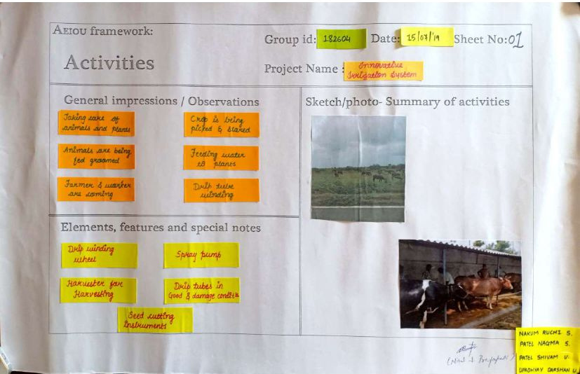
ACTIVITY CANVAS

Slide 11
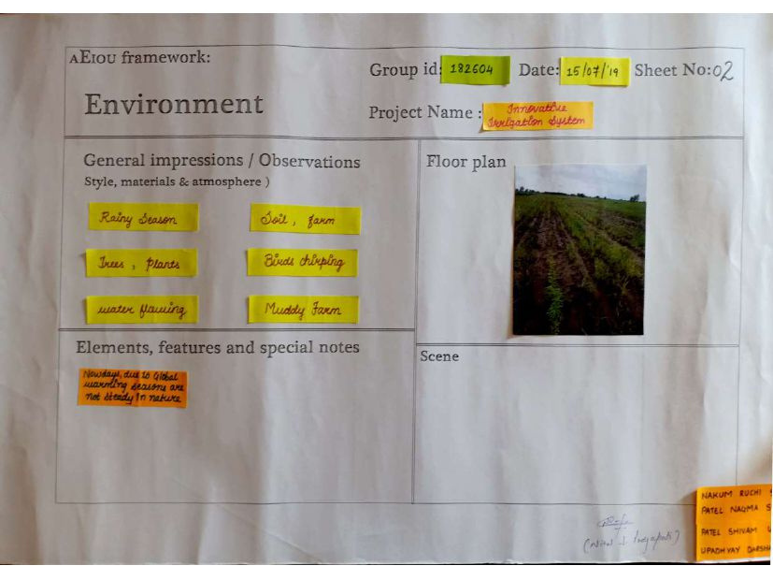
ENVIRONMENT
CANVAS

Slide 12
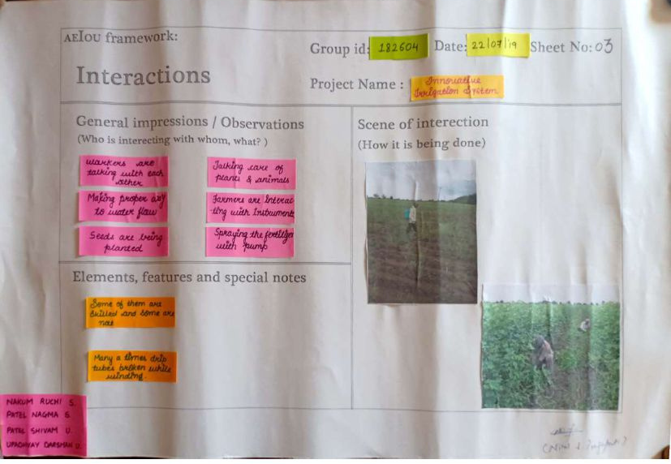
INTERACTION
CANVAS

Slide 13
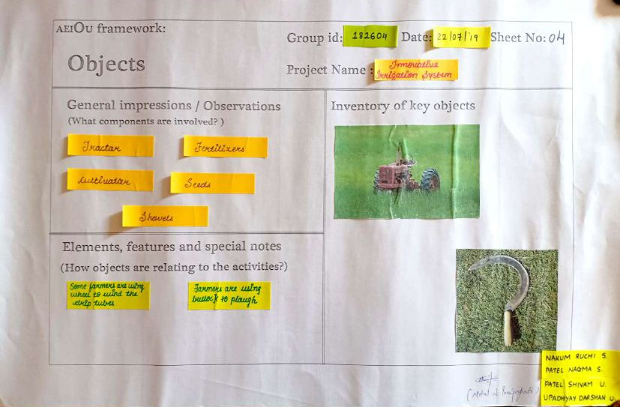
OBJECTS
CANVAS

Slide 14
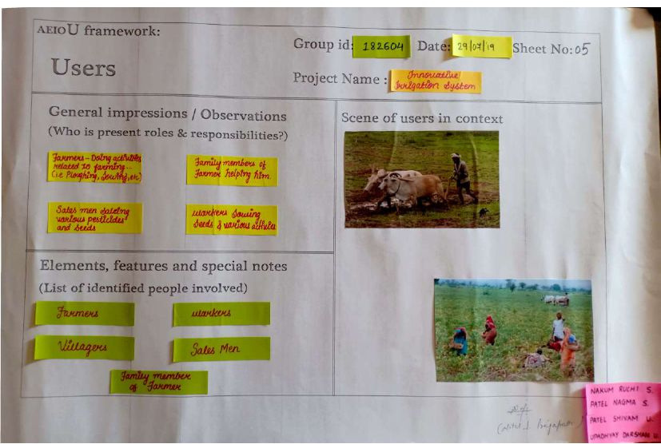
USER
CANVAS

Slide 15
EMPATHY
CANVAS

Slide 16
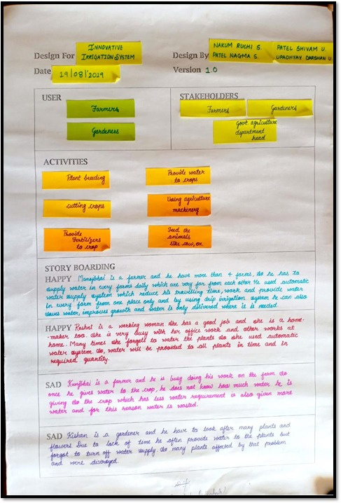
EMPATHY
CANVAS

Slide 17
IDEATION
CANVAS

Slide 18
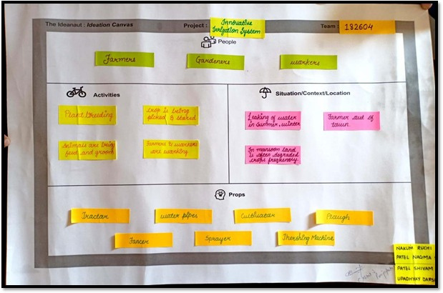
IDEATION
CANVAS

Slide 19
PRODUCT DEVELOPMENT
CANVAS

Slide 20
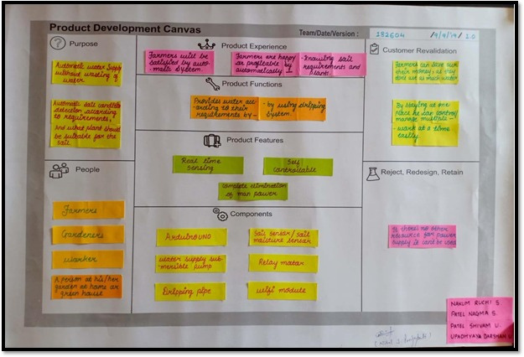
PRODUCT DEVELOPMENT
CANVAS

Slide 21
LNM
CANVAS

Slide 22
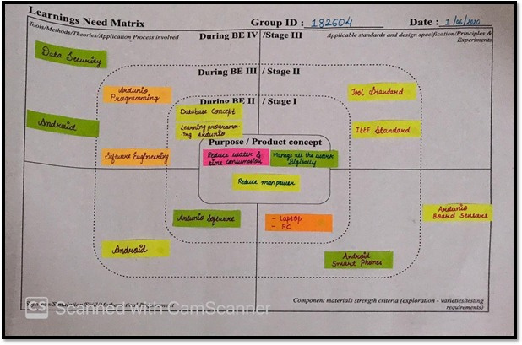
LNM
CANVAS

Slide 23
UML DIAGRAMS

Slide 24
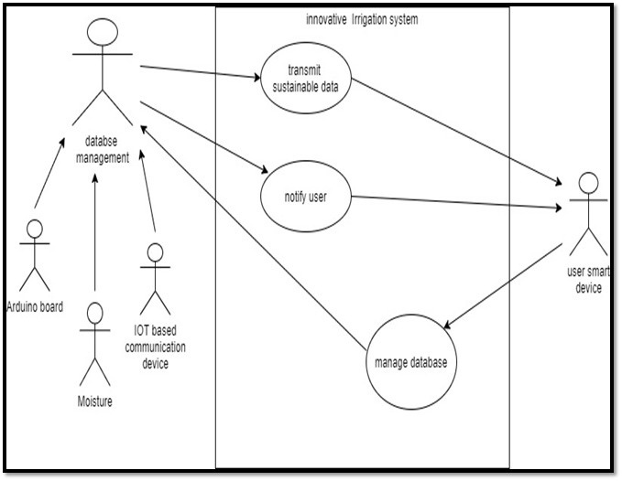
USE CASE DIAGRAM
The Use case diagram shows what will be the role of user and how user will work with our system. Simply it describes how the user deal with device which works with Arduino board, sensors and IOT based communication device [ User interaction and it’s relationship]

Slide 25
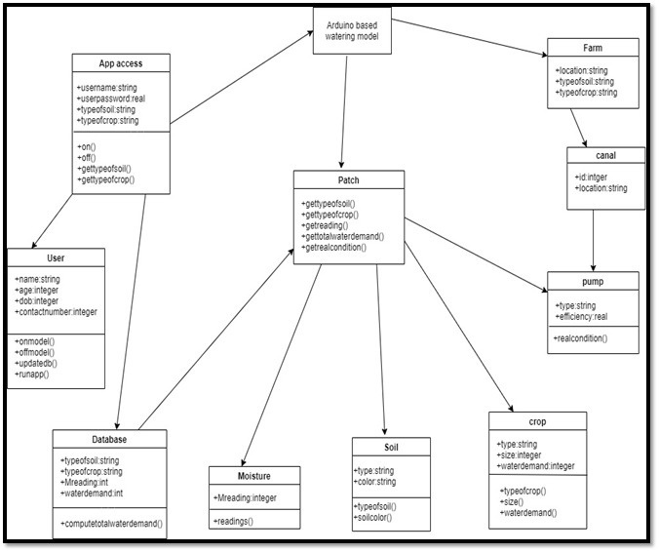
CLASS DIAGRAM
A class diagram is a type of static structure diagram that describes the structure of a system by showing the system's classes (i.e; User), their attributes (i.e; patch app access), operations (or methods), and the relationships among objects (such as pumps, moisture sensor etc) that how they are interrelated to each other.

Slide 26
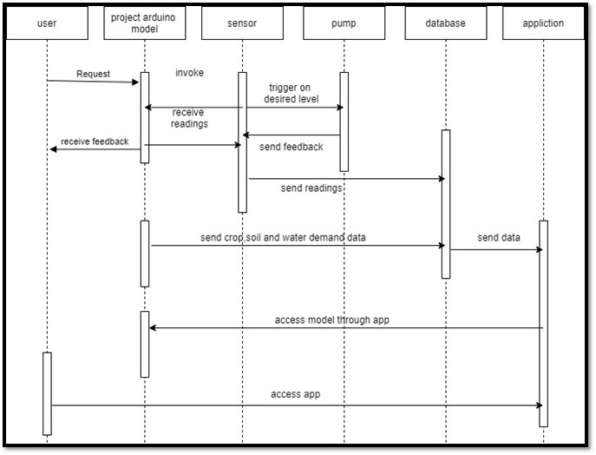
SEQUENCE DIAGRAM
The Sequence diagram demonstrates the sequence for which communication will be conveyed in our system. That the how user will invoke the request and it will travel to the final station (sensor). The system will access the information from sensors and send it to the application

Slide 27
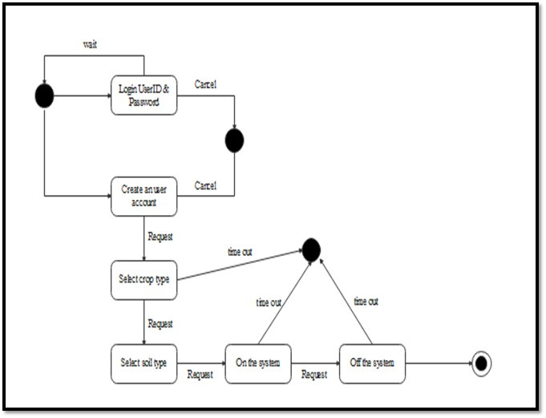
STATE DIAGRAM
The state diagram demonstrates the specific states that how user will be in as the system progressed in its function. Such as State 1 – shows how user will synced into the system and create account. State 2 – shows what the user want to select (type of selection) and State 3 – shows On and Off of the system

Slide 28
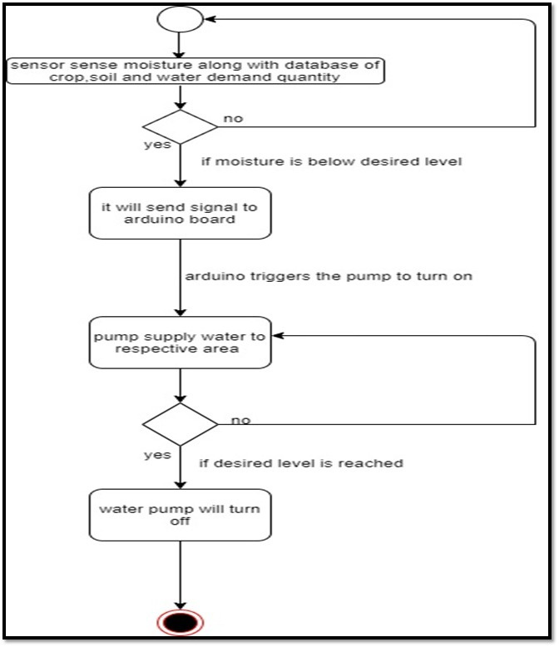
ACTIVITY DIAGRAM
The Activity diagram depicts the behavior of a system. That it potrays the control flow from start point to the end point (path to path) of the the system. It shows how the data is transmitted between the system internal part

Slide 29
PROTOTYPE
MODEL

Slide 30
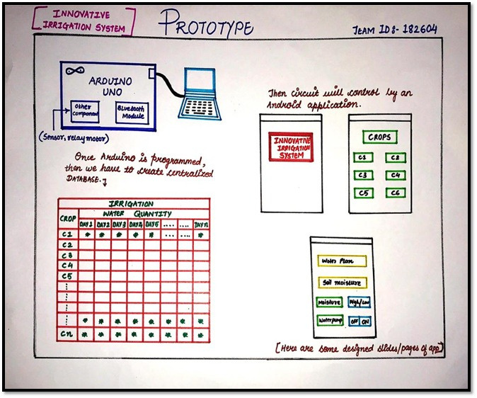

Slide 31
REQUIREMENTS

Slide 32
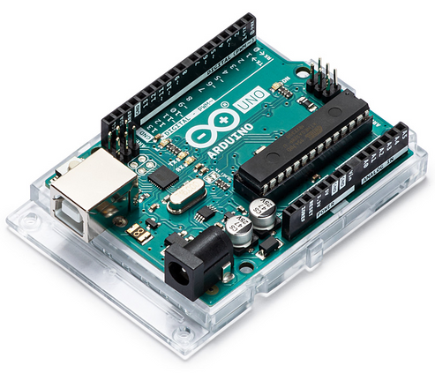
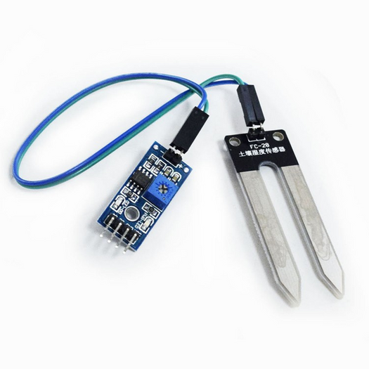
ARDUINO UNO
Arduino projects. Arduino consists of both a physical programmable circuit board often referred to as and a piece of, microcontroller software or IDE (Integrated Development Environment) that runs on your computer, used to write and upload computer code to the physical board.
SOIL MOISTURE SENSOR
Soil moisture is one kind of sensor used to detect the soil moisture content. it has two O/Ps like the analogue as well as the digital O/P. The working principle of the soil moisture sensor is open and short circuit concept.

Slide 33
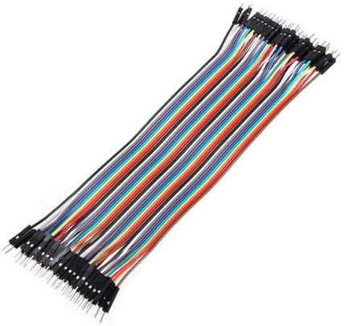
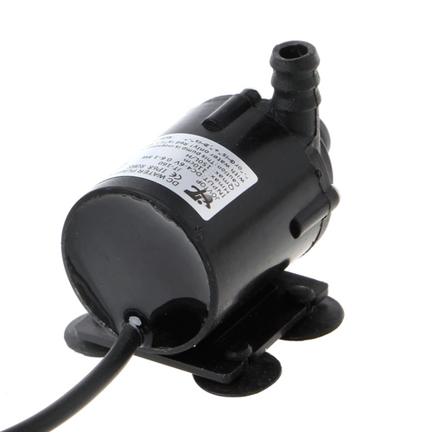
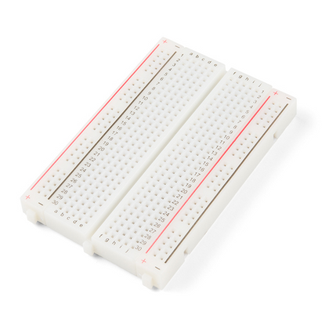
JUMP WIRE
It is an electrical wire, or group of them in a cable, with a connector at each end, which is normally used to interconnect the components of breadboard or other prototype or test circuit, internally or with other equipment or components, without soldering.
SUBMERSIBLE PUMP
Submersible pump is used to feed the water plants with operating voltage 5V.
BREADBOARD
A breadboard is a construction base for prototyping of electronics.

Slide 34
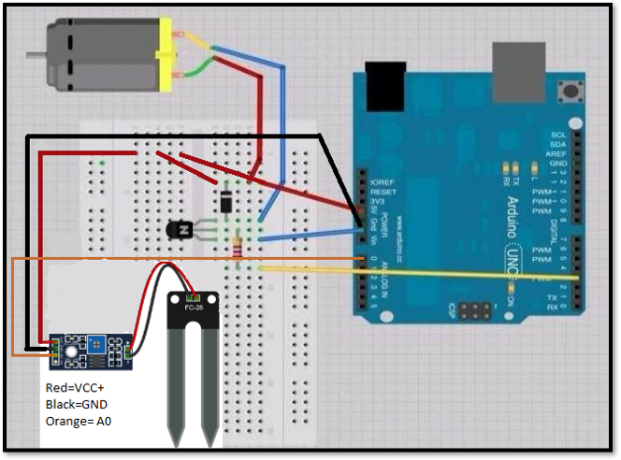

Slide 35
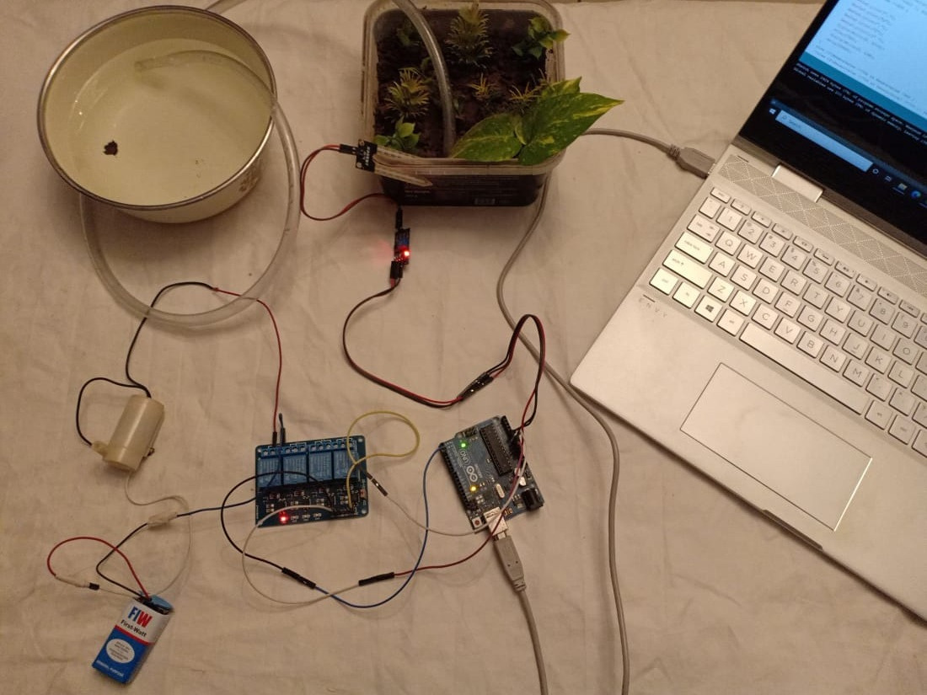

Slide 36
PLATFORM

Slide 37
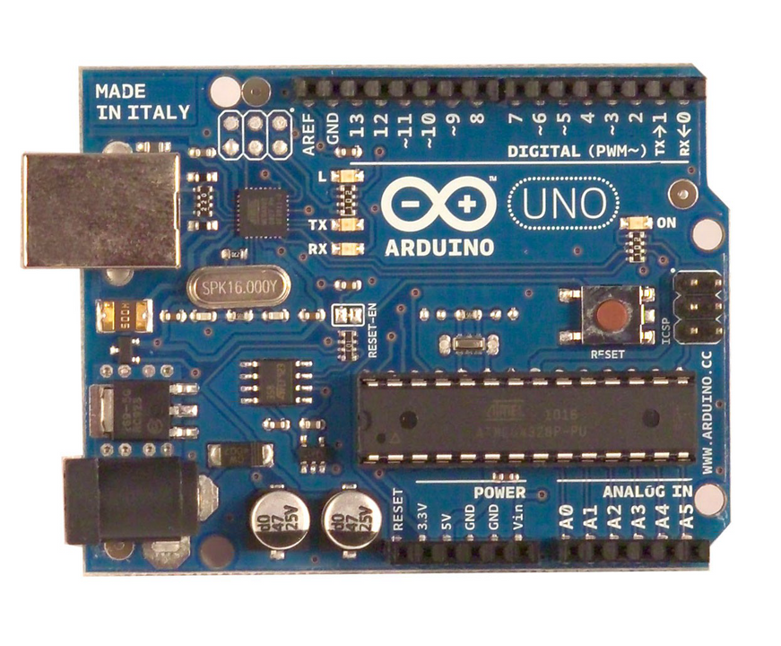
ARDUINO UNO
The Arduino Uno is a microcontroller board based on the ATmega328 . It has 14 digital input/output pins (of which 6 can be used as PWM outputs), 6 analog inputs, a 16 MHz crystal oscillator, a USB connection, a power jack, an ICSP header, and a reset button.It contains everything needed to support the microcontroller; simply connect it to

Slide 38
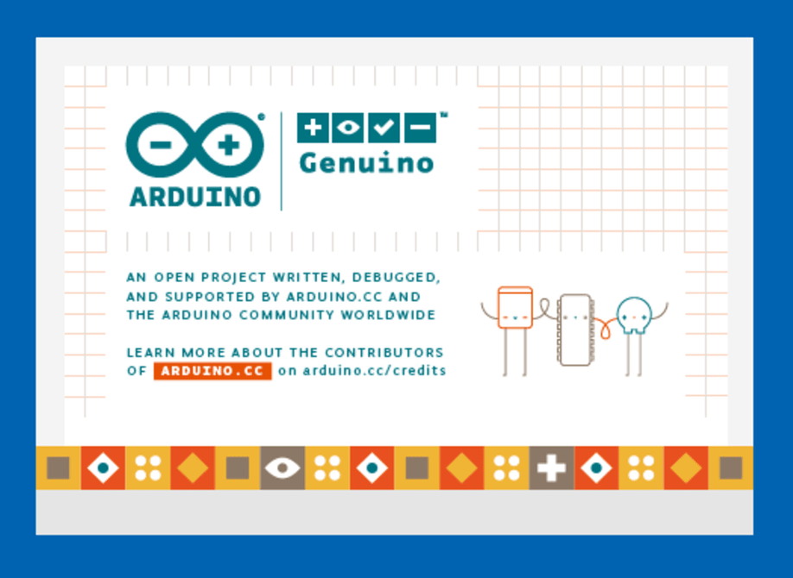
ARDUINO IDE SOFTWARE
The Arduino Integrated Development Environment (IDE) is a cross-platform application (for Windows, macOS, Linux) that is written in functions from C and C++. It is used to write and upload programs to Arduino compatible boards, but also, with the help of third-party cores, other vendor development boards.

Slide 39
VALIDATION

Slide 40
The methodology of expert systems as decision support aids in agriculture is undergoing rapid evolution. Questions of how to assess the appropriateness of these systems for their intended purposes and how much refinement to carry out have not yet been adequately addressed.
While it is sometimes possible to compare the output of an expert system against that of a human expert, many practical difficulties can arise; also, this may not be a meaningful comparison if the expert system has access to different information to the human expert.
Some of the evaluation procedures for farming systems models, as well as some of the pitfalls of these procedures, are relevant to the testing of expert systems.
Judgment of the market place will be an important component of system evaluation.

Slide 41
THE PROBLEM MAY CAUSE IN OUR SYSTEM
In our system, there may cause a problem with hardware components. In monsoon season there may occur some water-related problem on hardware component. So, we have to protect it further. Access to water also causes some problems. In, water accessing from the pump the speed of releasing water is very high. Hence, the water tank will gradually empty and waste of water will occur

Slide 42
ADVANTAGES
To save water
Smart irrigation also deals with efficiencies in the delivery of the water. There are generally four types of delivery: surface, sprinklers, trickle and subsurface methods.
It distributes water through irrigation ditches, letting gravity do the work.
Sprinklers distribute water through the air like rain and can be fixed or mobile.
Trickle irrigation spreads water very locally to the ground surface.
Controlling these two set points reduces the amount of water used by linking it to the moisture level needed in the soil for a particular crop.
A particular land area is too dry and starting an irrigation routine or to stop irrigation when a particular saturation point is met because a soil moisture level has been reached.
Use local soil moisture data drawn from sensors in the ground to support informed decisions about watering schedules.

Slide 43
DISADVANTAGES
Agriculture being a natural phenomenon relies mostly on nature, and man predict or control nature let it be rain drought sunlight availability. pests control etc. So ever implementation loT system agriculture.
The smart agriculture need availability on internet continuously. Rural part of the developing countries did not fulfill this requirements Moreover internet is slower.
Fault sensor or data processing engines can cause faulty I decisions which may lead to over use of water, fertilizers and other wastage of resources.
The smart farming based equipment require farmer to understand and learn the use of technology. This is the major challenge in adopting smart agriculture framing at large scale across the continues.
It also has some issues which have to be tracked properly in order to attain the full benefit of it.

Slide 44
FUTURE SCOPE
We can interface LCD screen in order to display the current status of the soil moisture content levels, percentage of water utilized to water the plant, duration of time for which the water pump is ON, etc.
We can also show the graphical representation of the moisture content levels in the soil.
To improve the efficiency and effectiveness of the system, the following recommendations can be put into consideration.
Option of controlling the water pump can be given to the farmer.
The farmer may choose to stop the growth of crops or the crops may get damaged due to adverse weather conditions.
In such cases farmer may need to stop the system remotely.
The idea of using IOT for irrigation can be extended further to other activities in farming such as cattle management, fire detection and climate control. This would minimize human intervention in farming activities

Slide 45
Thank you

